Slide 1


Reproducible Web Corpora: Interactive Archiving with Automatic Quality Assessment
https://dl.acm.org/doi/10.1145/3239574
JOHANNES KIESEL
FLORIAN KNEIST
MILAD ALSHOMARY
BENNO STEIN
MATTHIAS HAGEN
MARTIN POTTHAST
Bauhaus-Universität Weimar
Ulm University
Paderborn University
Bauhaus-Universität Weimar
Martin-Luther-Universität Halle-Wittenberg
Leipzig University
Presented by David Calano
CS 895 - Web Archiving Forensics
Old Dominion University
November 7th, 2022
@lifefromalaptop
@WebSciDL
CS895 - Web Archiving Forensics
Fall 2022

Slide 2
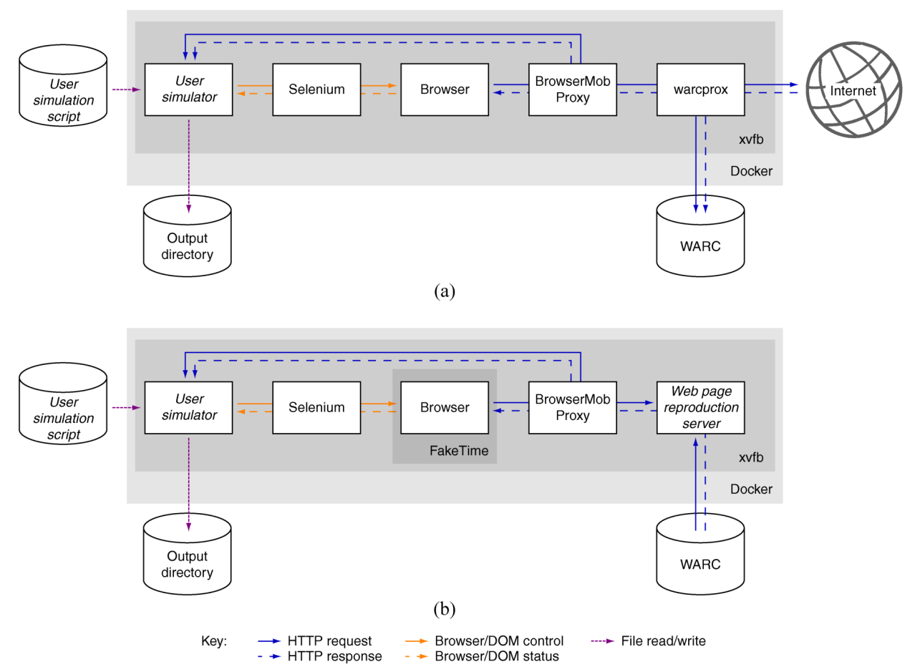
Webis Web Archiver
Mostly identical crawl and reproduction process
https://github.com/webis-de/webis-web-archiver
https://github.com/webis-de/scriptor
Figure 1
@lifefromalaptop
@WebSciDL
CS895 - Web Archiving Forensics
Fall 2022

Slide 3
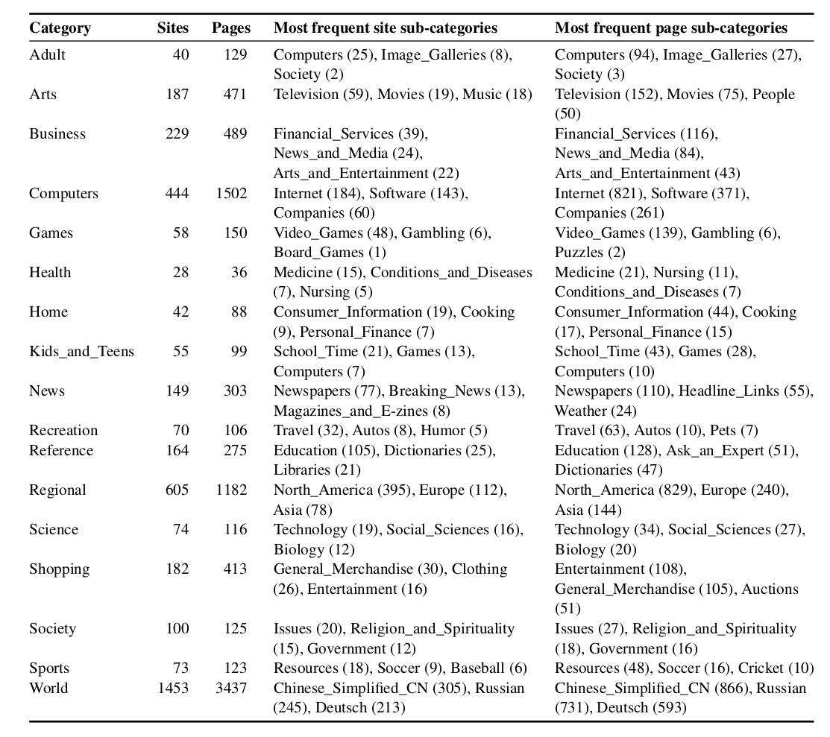
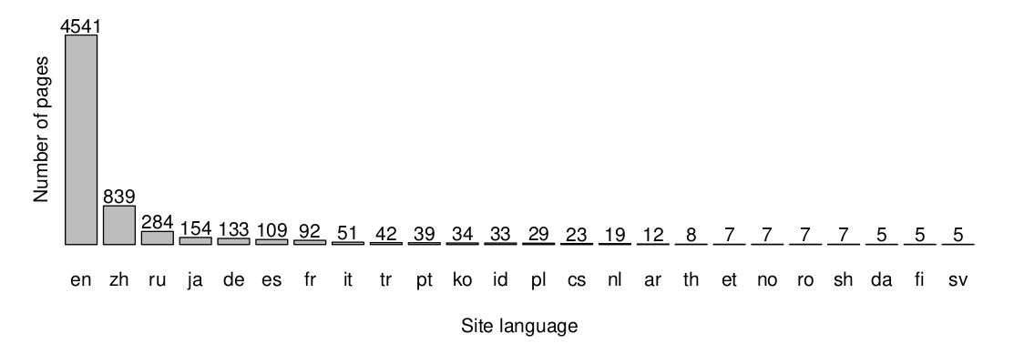
Breakdown of Dataset
~65% success in determining language using Alexa
Table 1
https://alexa.com/topsites
https://webis.de/data/webis-web-archive-17.html
Figure 3
@lifefromalaptop
@WebSciDL
CS895 - Web Archiving Forensics
Fall 2022

Slide 4
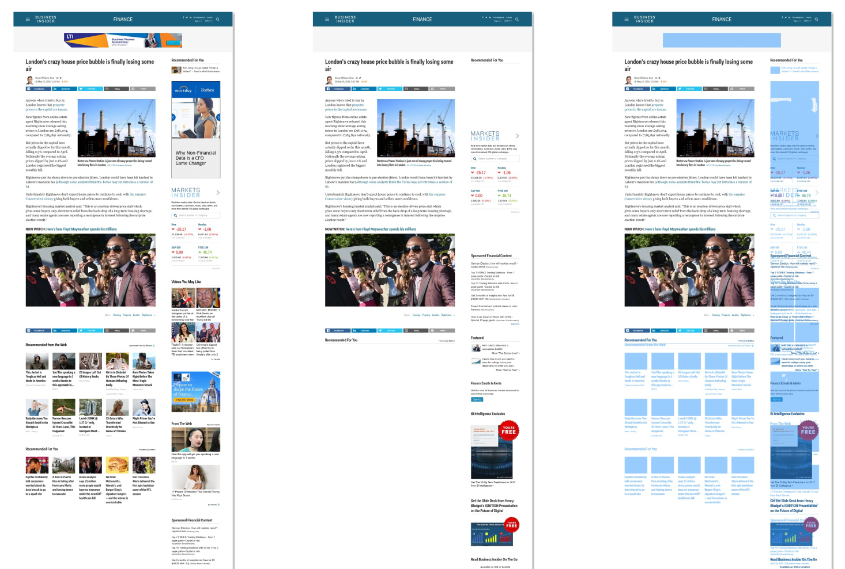
Web Capture vs Playback
Annotations used to highlight page differences for Mechanical Turk agents and researchers
Figure 2
@lifefromalaptop
@WebSciDL
CS895 - Web Archiving Forensics
Fall 2022

Slide 5
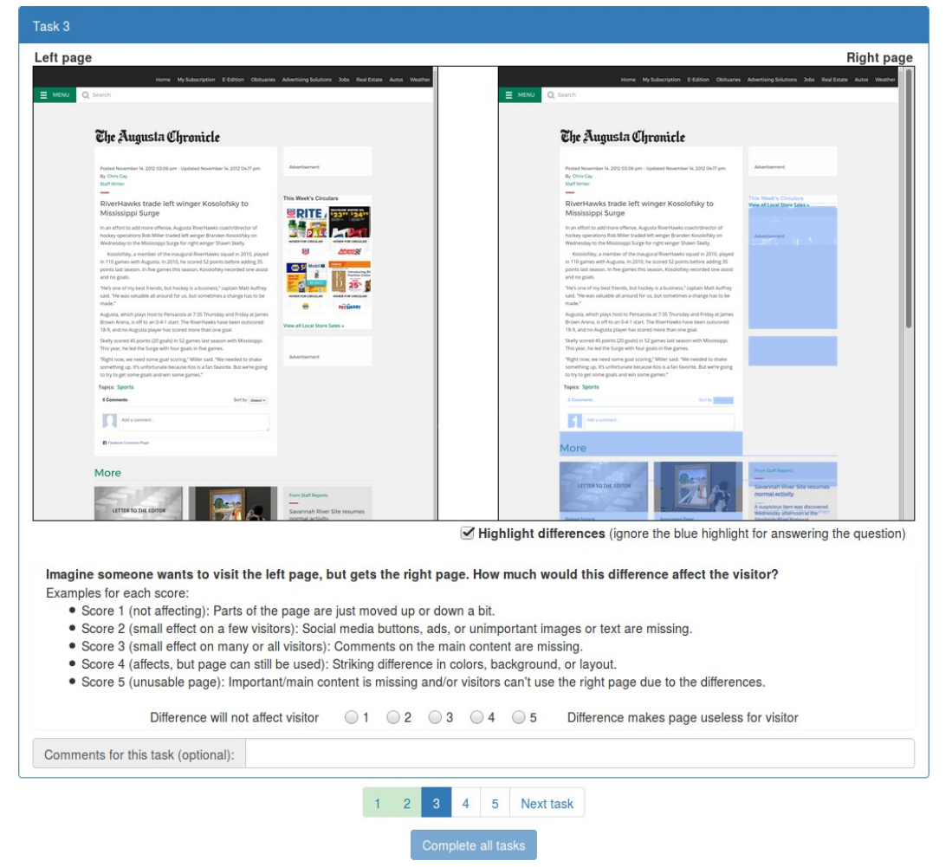
Mechanical Turk Used to Test Perceived Differences
1 for “best”
5 for “worst”
Figure 4
https://www.mturk.com/
@lifefromalaptop
@WebSciDL
CS895 - Web Archiving Forensics
Fall 2022

Slide 6
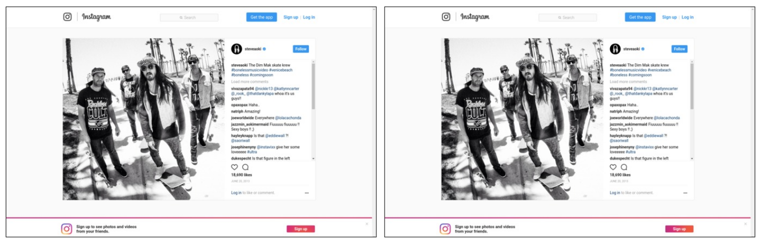
1: Page Differences Have Negligible Effects
Figure 5
Slight difference in colors of animated button
@lifefromalaptop
@WebSciDL
CS895 - Web Archiving Forensics
Fall 2022

Slide 7
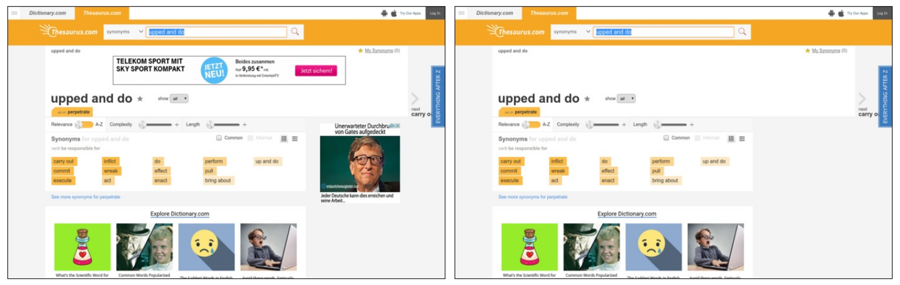
2: Small Issues Affecting Small Numbers of People
Missing advertisements
Figure 5
@lifefromalaptop
@WebSciDL
CS895 - Web Archiving Forensics
Fall 2022

Slide 8
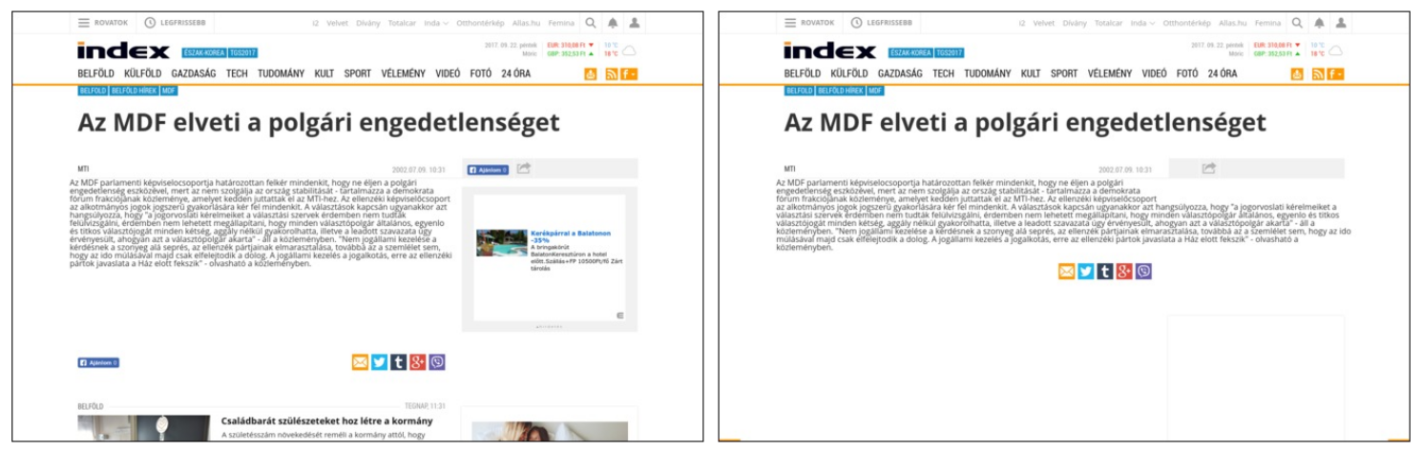
3: Page Has Small But Pervasive Differences
Social buttons and related articles section missing
Figure 5
@lifefromalaptop
@WebSciDL
CS895 - Web Archiving Forensics
Fall 2022

Slide 9
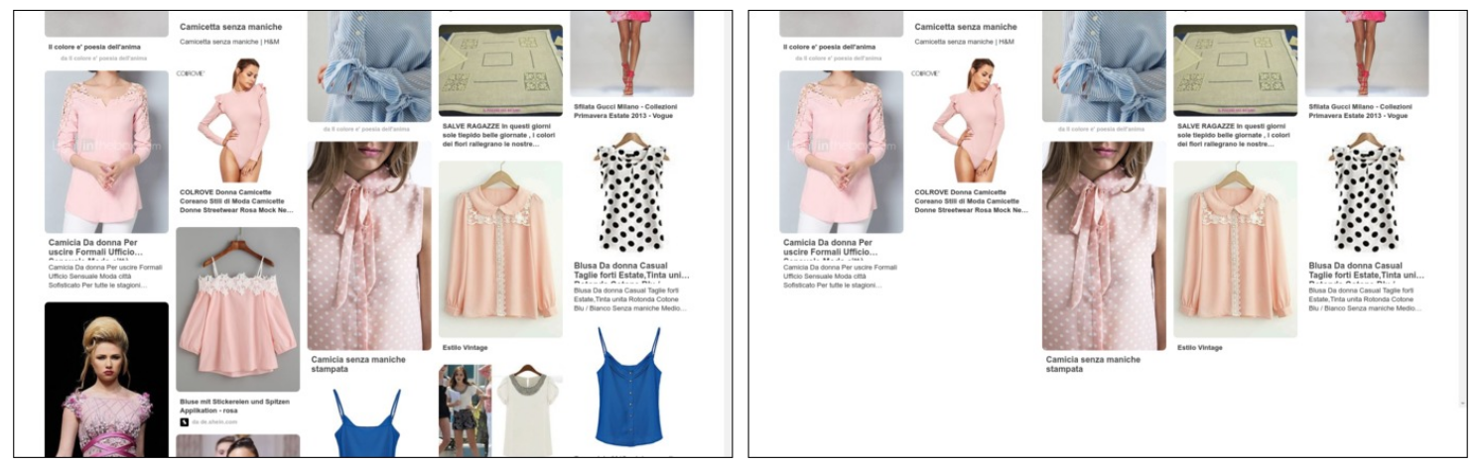
4: Page Is Usable Despite Significant Differences
Missing content not loaded at page initialization
Figure 5
@lifefromalaptop
@WebSciDL
CS895 - Web Archiving Forensics
Fall 2022

Slide 10
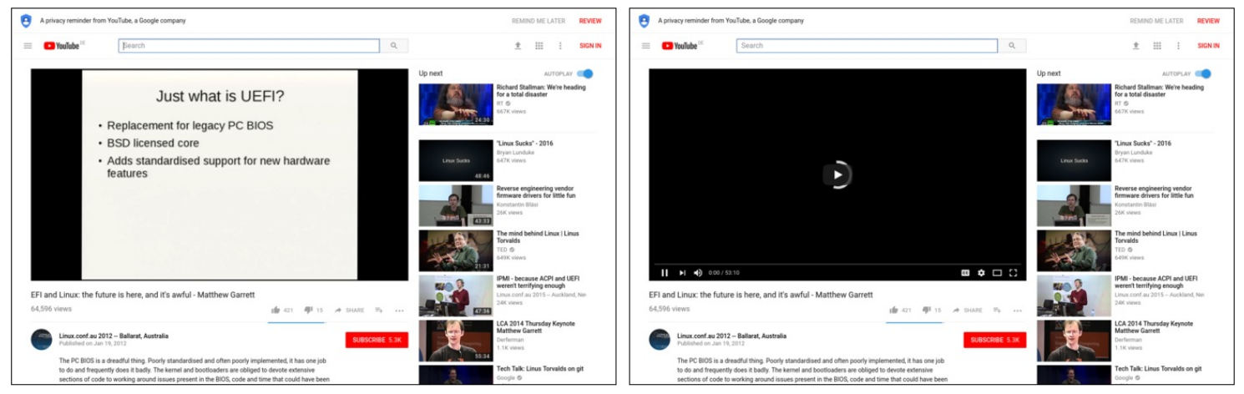
5: Page Is Effectively Unusable
Figure 5
Primary content of page is missing or non-functional
@lifefromalaptop
@WebSciDL
CS895 - Web Archiving Forensics
Fall 2022

Slide 11
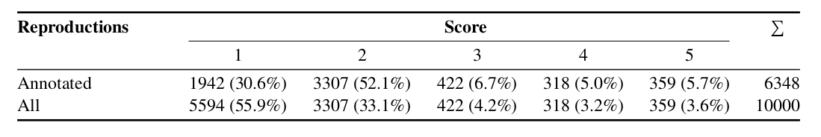
Crowdsourced Score Breakdown
Table 2
Unannotated pages were reconfirmed by Mechanical Turk agents
@lifefromalaptop
@WebSciDL
CS895 - Web Archiving Forensics
Fall 2022
Notes:
Manual review for scored pages which were scores of both 1 and 5 were simultaneously given by different agents or for pages where an individual agent scored a page above or below the median score by 3 points.
In 81% of the cases, more than half of the accepted annotators agreed on a score.

Slide 12
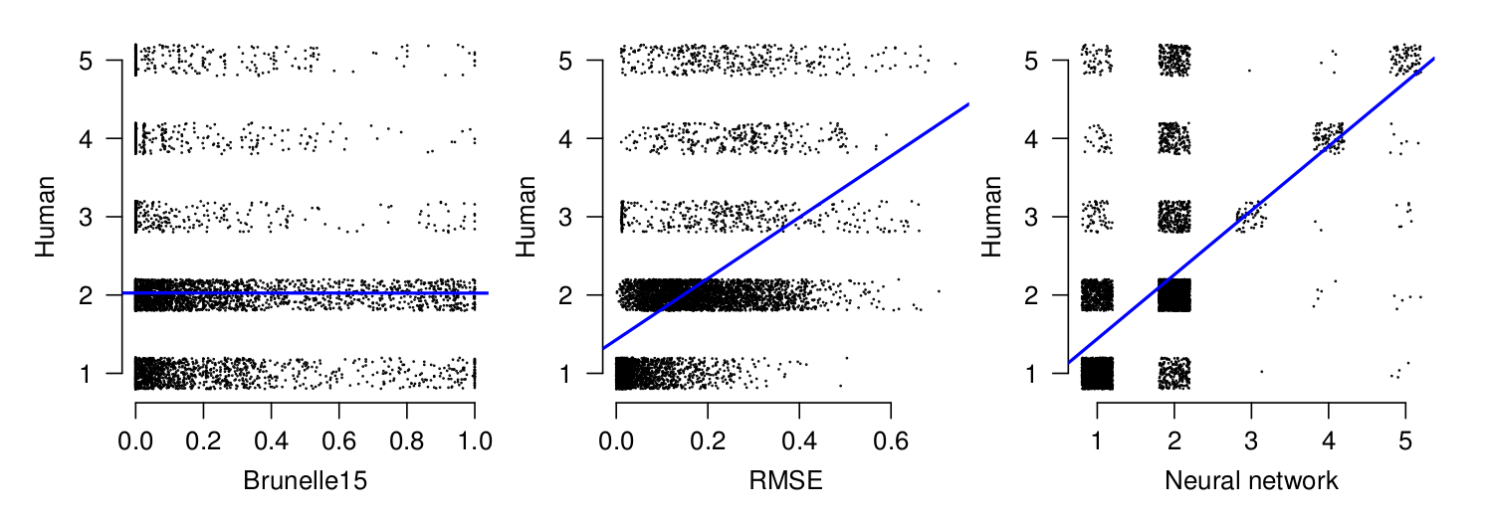
Algorithm Comparison
https://en.wikipedia.org/wiki/Pearson_correlation_coefficient
https://en.wikipedia.org/wiki/Root-mean-square_deviation
http://justinfbrunelle.com/pubs/jcdl-2014-brunelle-damage.pdf
https://ws-dl.blogspot.com/2018/09/2018-09-03-lets-compare-memento-damage.html
Figure 6
r = 0.0
r = 0.48
r = 0.57
Pearson Correlation Coefficient measures linear correlation between algorithmic results
@lifefromalaptop
@WebSciDL
CS895 - Web Archiving Forensics
Fall 2022

Slide 13
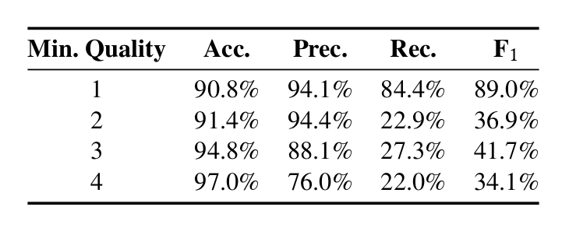
Neural Network Accuracy
Table 3
Useful for automatically determining pages if were not faithfully reproduced
Most important metric for debugging
Calculations exclude trivial cases with no difference to screenshots
@lifefromalaptop
@WebSciDL
CS895 - Web Archiving Forensics
Fall 2022

Slide 14
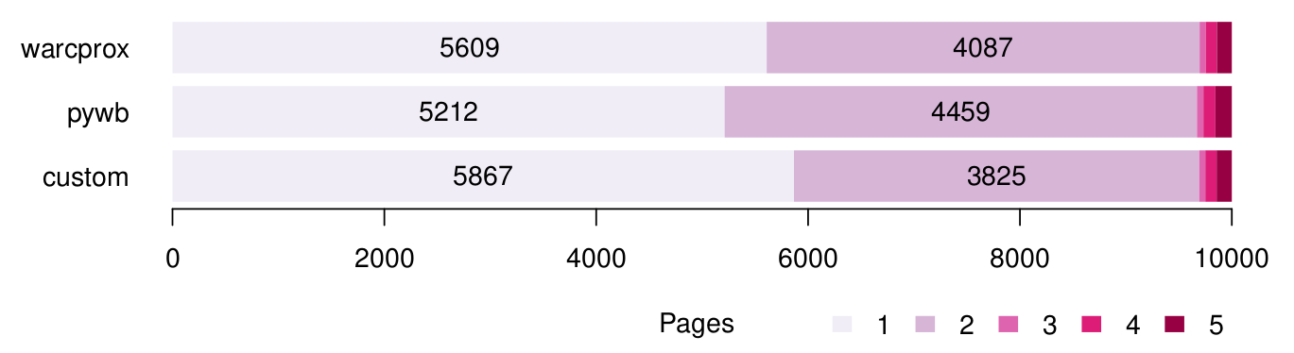
Comparison of Faithful Reproducibility for Replay Engines
Figure 7
2.58% improvement over warcprox
6.55% improvement over pywb
https://github.com/internetarchive/warcprox
https://github.com/webrecorder/pywb
@lifefromalaptop
@WebSciDL
CS895 - Web Archiving Forensics
Fall 2022

Slide 15
Conclusions
Sample data set could be larger to improve accuracy and edge cases
Using screenshot comparisons, neural networks can be trained to rapidly assess reproduced web page quality
Move to automated calculation approaches over heuristics
Check out Justin Brunelle’s WS-DL blog post for more details: https://ws-dl.blogspot.com/2018/09/2018-09-03-lets-compare-memento-damage.html
@lifefromalaptop
@WebSciDL
CS895 - Web Archiving Forensics
Fall 2022

